Slide 1
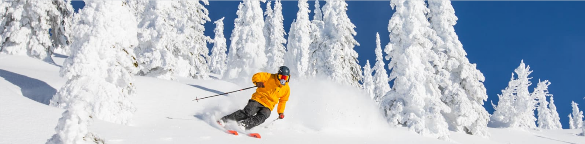
Guided Capstone Project Presentation
“Big Mountain ski resort”
by Yuriy Sereda
Problem Statement
Big Mountain ski resort in Montana recently installed an additional chair lift to help increase the distribution of visitors across the mountain at the expense of increasing their operating costs by $1,540,000 this season. The company suspects they are not getting the most out of their facilities and needs some guidance on how to adjust their pricing and investment into existing and new facilities.

Slide 2
Recommendation and key findings
Proceed with the most profitable Scenario 2:
Add 1 run.
Add 150 ft to the vertical drop.
Add one chair lift.
Expected increase in daily ticket price is $1.99 and extra $1.93M in seasonal revenue.
Do not close runs as in Scenario 1:
Loss of up to $1.81M in profit.
Potential loss in vertical drop, night skiing area, etc.
Scenario 3 only adds expenses for 2 acres of artificial snow compared to the best scenario.
Scenario 4 does not lead to a change in ticket price, while adding the cost of 4 acres of artificial snow.
Start collecting visitor and operating cost data.

Slide 3
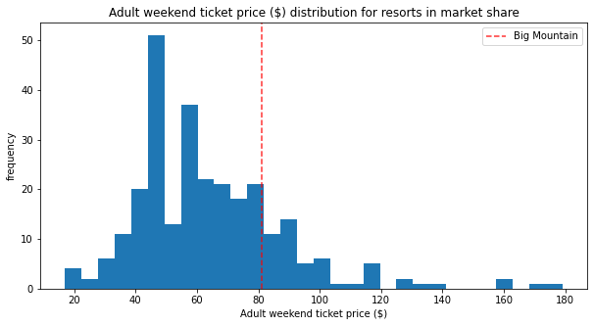
Modeling results and analysis
Explanatory variables: 29 features of US resorts.
Dependent variable: weekend ticket prices in US resorts.
Montana has a moderate state-wide average price; weekday and weekend prices coincide.
Daily ticket price at Big Mountain Resort is at 80.4 percentile across 276 US resorts with given weekend prices.

Slide 4
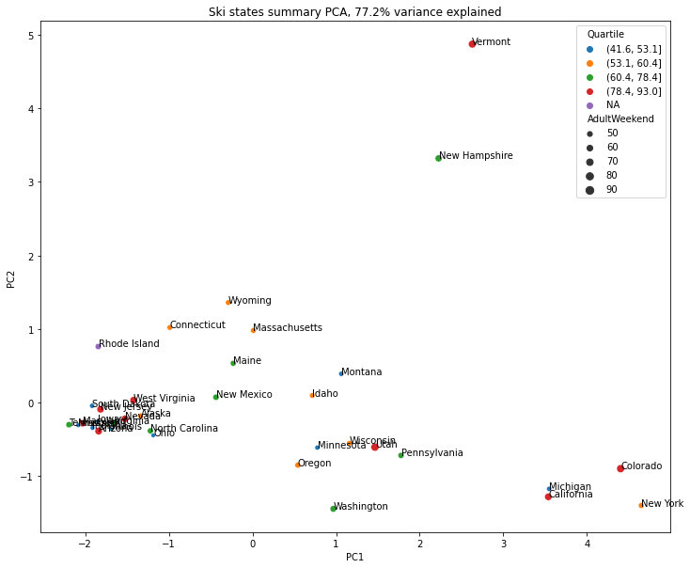
PCA analysis
No clear pattern in PCA coordinates of state-wide average prices. Need to apply another regression technique.

Slide 5
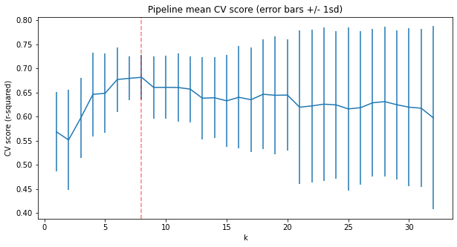
Key factors determining ticket price
Random Forest model is more consistent than Linear Regression model in predicting daily ticket prices.
Optimal number of features in RF model is eight.
Percentiles for important features are considerably higher
Features | Price, $ | Vertical Drop, ft | Snow Making Area, acres | Total Chairs | Fast Quads | Runs | Longest Run, mi | Trams | Skiable Area, acres
Current Value | 81 | 2353 | 600 | 14 | 3 | 105 | 3.3 | 0 | 3000
Percentile | 80.4 | 89.9 | 84.4 | 95.3 | 95.3 | 92.4 | 94.2 | 92.0 | 97.8
Tickets are underpriced, there is a potential for price increase

Slide 6
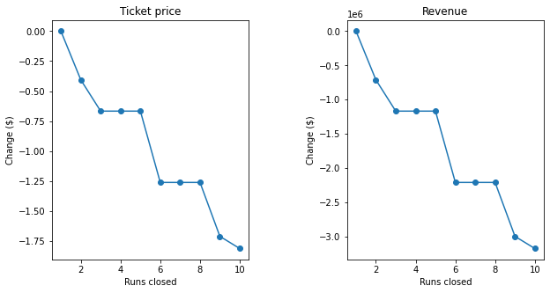
Random Forest model predictions
Ranking of business scenarios: 2 (best), 3, 4, and 1 (worst).
Scenario 1: Closing some runs leads to a lost profit.
Extra 2 and 4 acres of artificial snow in Scenarios 3 and 4, and stretching the longest run by 0.2 miles in Scenario 4 are not sufficient to make tickets grow in price. Only adds costs.
Features | Vertical drop (ft) | Snow making (acres) | Total chairs | Runs | Longest run (mi) | Price ($) | Revenue ($) | Profit ($)
Scenario 1 | 0* | 0* | 0* | [-10, -1] | 0* | [-1.81, 0] | [-1.8M, 0] | [-10, 0] × RC**
2 | 150 | 0* | 1 | 1 | 0* | 1.99 | 3474638 | 1934638
3 | 150 | 2 | 1 | 1 | 0* | 1.99 | 3474638 | 1934638 - 2×SMOC***
4 | 0 | 4 | 0 | 0 | 0.2 | 0 | 0 | -4×SMOC

Slide 7
Summary and conclusion
In absence of changes to facilities, RF regression model predicts the justified weekend ticket price of $95.87 with standard deviation of $10.39.
The best strategy is to invest in extra chair lifts to add runs and increase vertical drop. Additional $1.93M in seasonal profit is predicted in Scenario 2.
To improve the accuracy of price predictions:
collect missing price data for some resorts,
build a complementary model for weekday prices,
collect customer count data for all resorts.
Estimate operating costs:
collect resource usage data for all types of equipment,
collect data on resource cost (electricity, gas, water, and labor) for each resort location.
Evaluate scenarios involving other influential factors.

